Slide 1
SUPPORTING BROADER IMPACTS IN FIELD CAMPAIGNS
NCAR EDUCATION, ENGAGEMENT & EARLY-CAREER DEVELOPMENT (EdEC)
DANIEL W. ZIETLOW & EVY McUMBER
NCAR EdEC
9 MAY 2023
Notes:
my name is …
Happy to share how you can collaborate with EdEC, which is the new and expanded E&O program at NCAR. Some of you might have already passed by our table in the lobby and picked up some materials, here I am providing a quick overview….

Slide 2
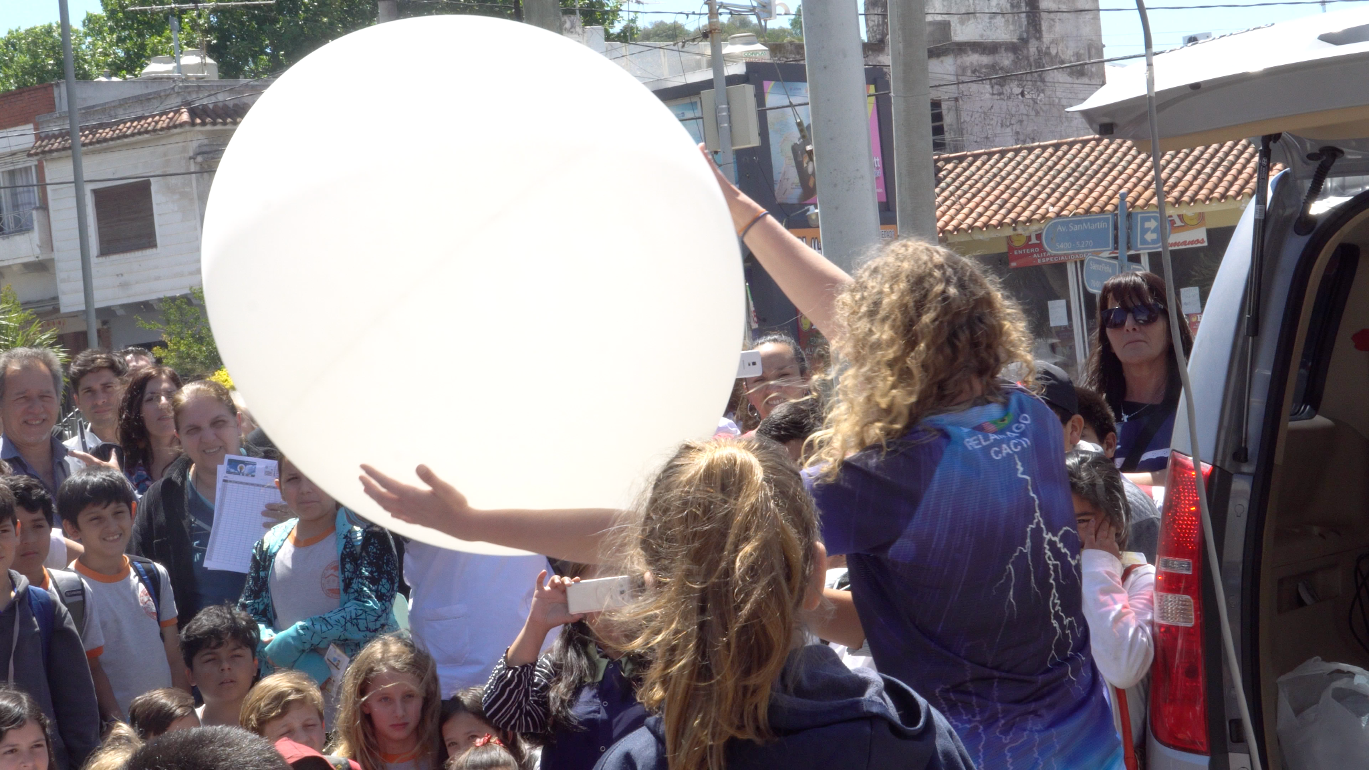
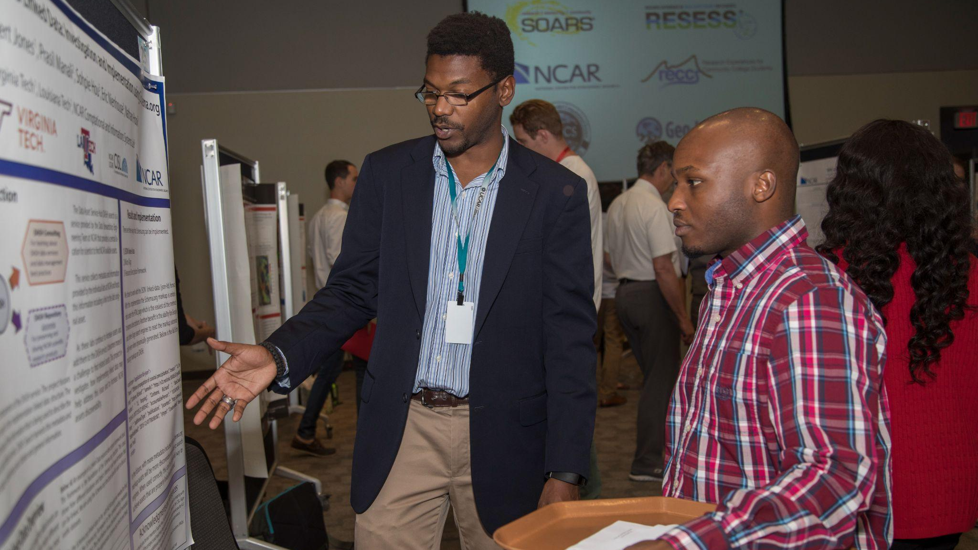
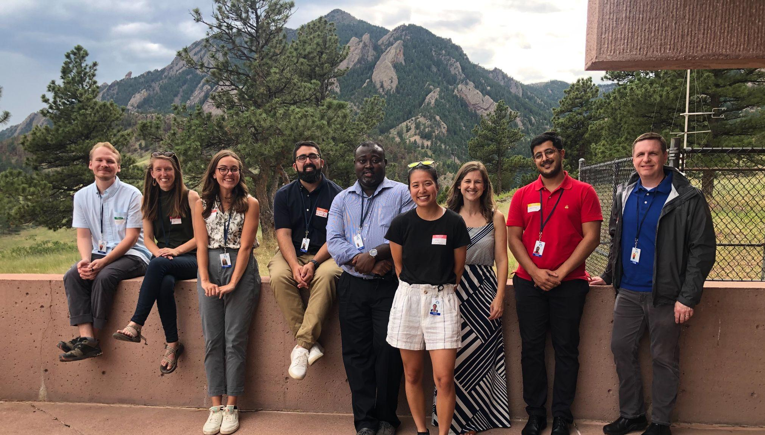
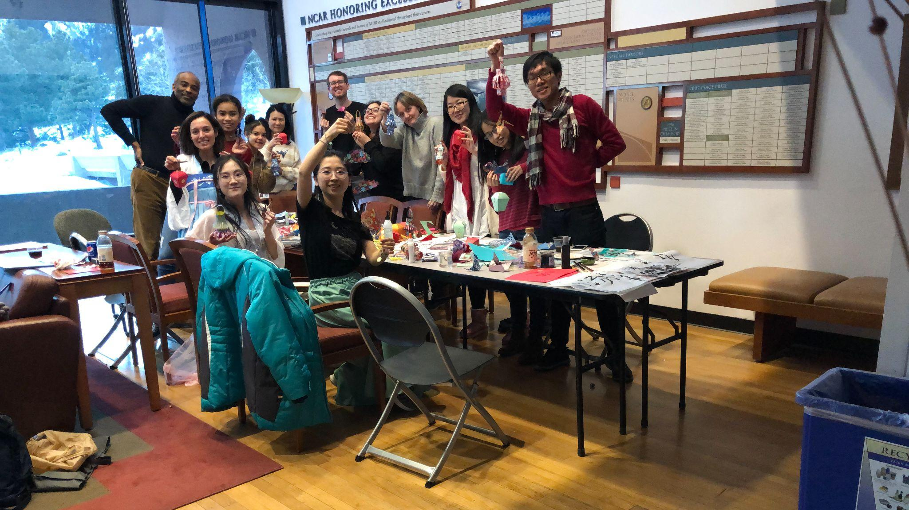
NCAR Education, Engagement & Early-Career Development (EdEC)...
…supports, enhances, and extends the capabilities of the university community
and the broader Earth system science community.
ENGAGEMENT
FUTURE WORKFORCE
UNIVERSITY PARTNERSHIPS
EARLY-CAREER DEVELOPMENT
EdEC
Notes:
EdEC has four sections plus a number of cross-cutting experts:
Engagement - public events, traveling exhibits, multimedia
Future Workforce - internships, ASP
University Partnerships - MSI partnerships, REU Network, Innovator Program
Early-Career Development - new; PD for NCAR/UCAR/UCP staff

Slide 3
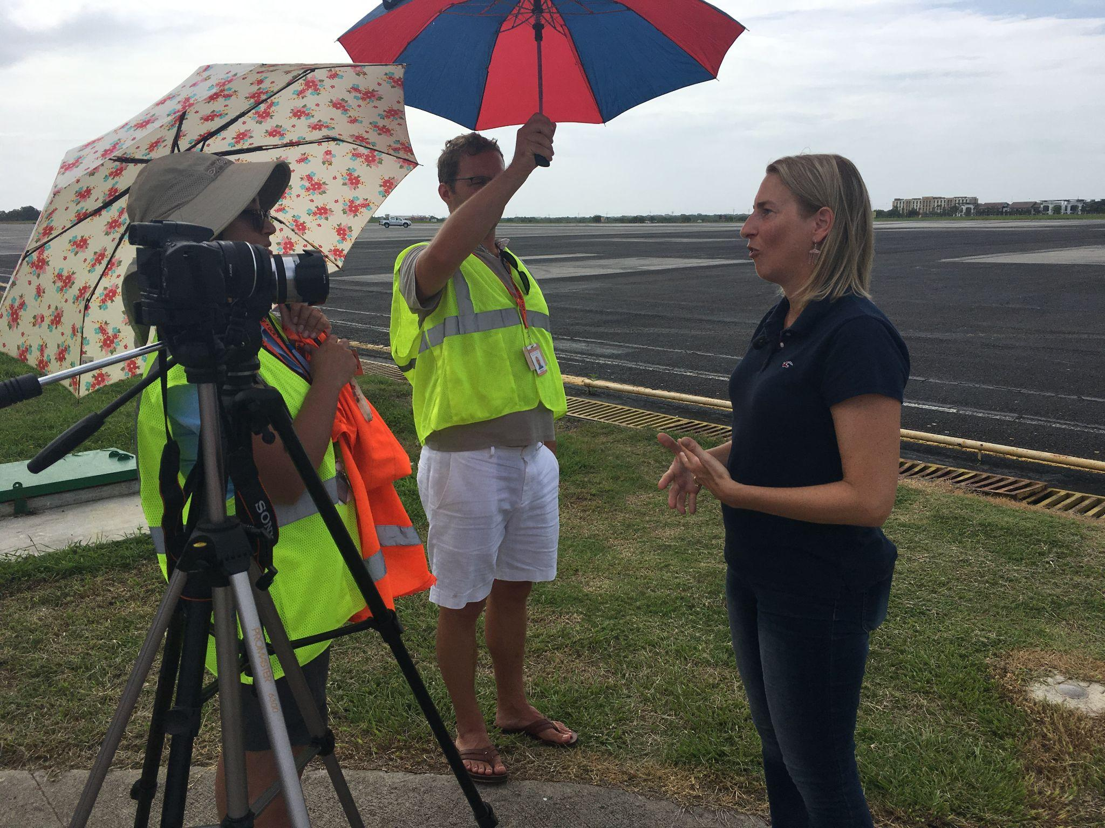
Supporting Field Campaigns Through Public Engagement
We can support the engagement component of your field campaign:
Instrumentation Open Houses
K12 & University Classroom Visits
Students in the Field
Teacher Curriculum
Video Production
Educational Handouts
The PI of the OTREC field campaign is interviewed for a video series about the field campaign.
EdEC
Notes:
We’re having a session later today about Bringing the Experts to the World through Streaming Documentaries

