Slide 1
CAESAR: Characterizing and Understanding Atmospheric Boundary Layer Fluxes, Structure and Cloud Property Evolution in Arctic Cold Air Outbreaks
Zhien Wang and Flynn Mcginnity
University of Colorado, Boulder and Stony Brook University (Starting at Sep. 1st)
and
John Cassano and TBD
University of Colorado, Boulder
Instruments
MARLi: No changes
Airborne Doppler Lidar (ADL): From nadir only to a five-beam system

Slide 2
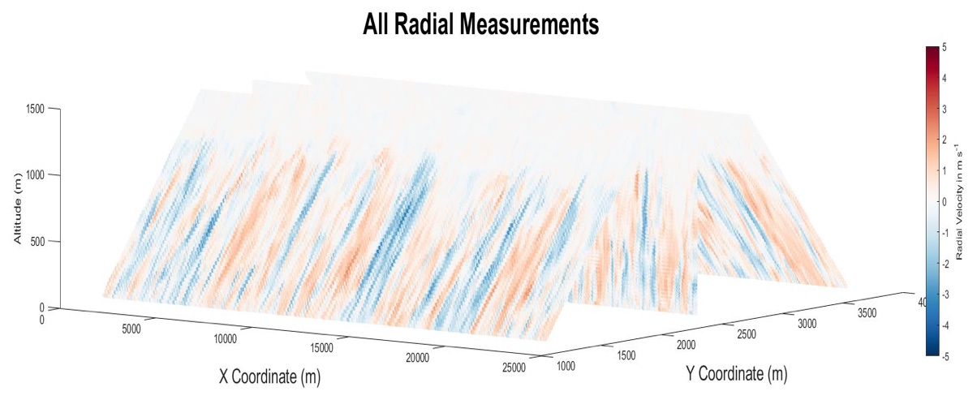
The Synergy of Raman and Doppler Lidar Measurements
Five Fixed-beam Airborne Doppler Lidar (ADL)
Raman Lidar
Wind and Turbulence profiling
Water vapor, temperature, and aerosol profiling
Sensible and Latent heat flux profiles from below cloud legs.
Notes:
Advancing Future PBL Observations
Space-based PBL observations will be limited and take time.
Airborne simultaneous measurements of Dynamics and thermodynamics are essential for PBL processes study.
True mobile measurements to deal with spatial heterogeneity.

Slide 3
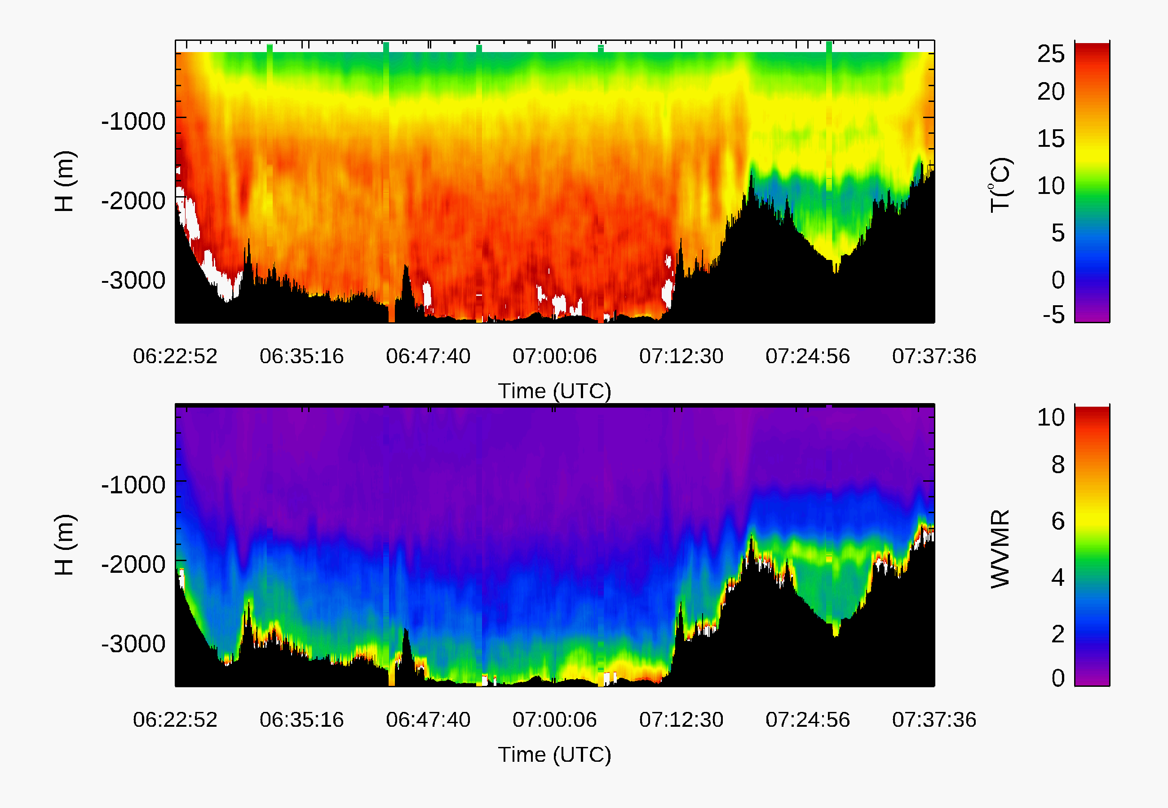
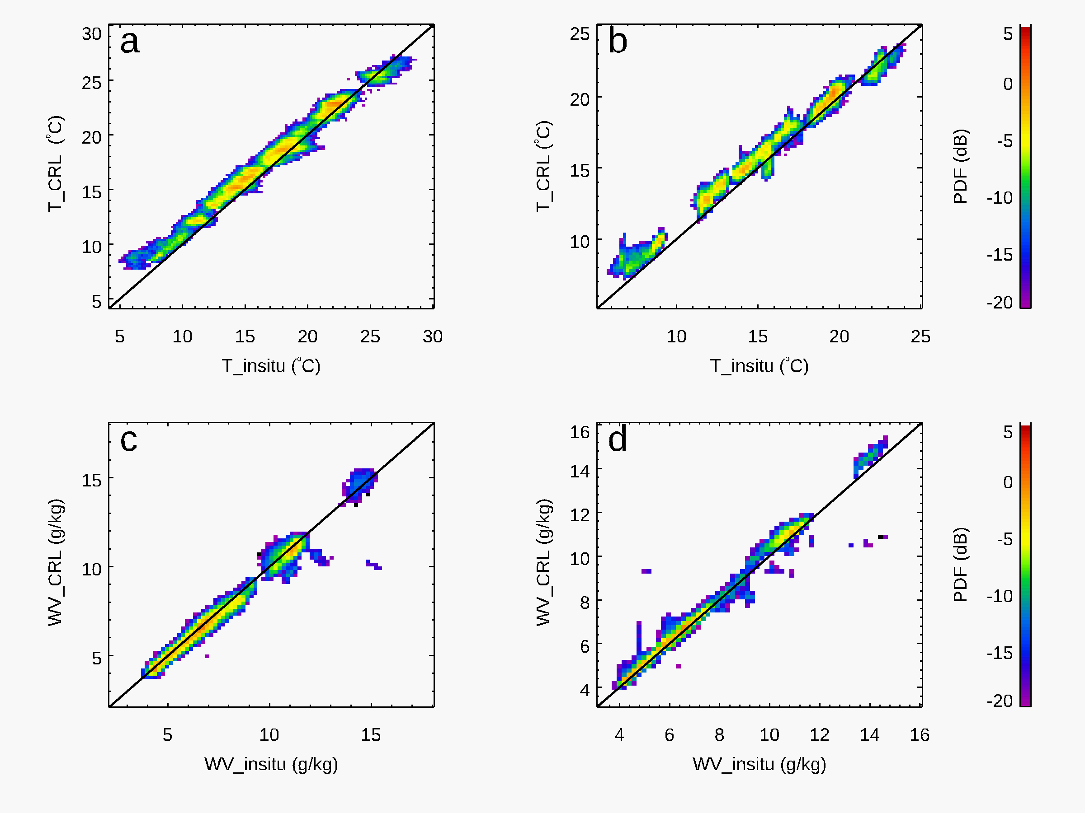
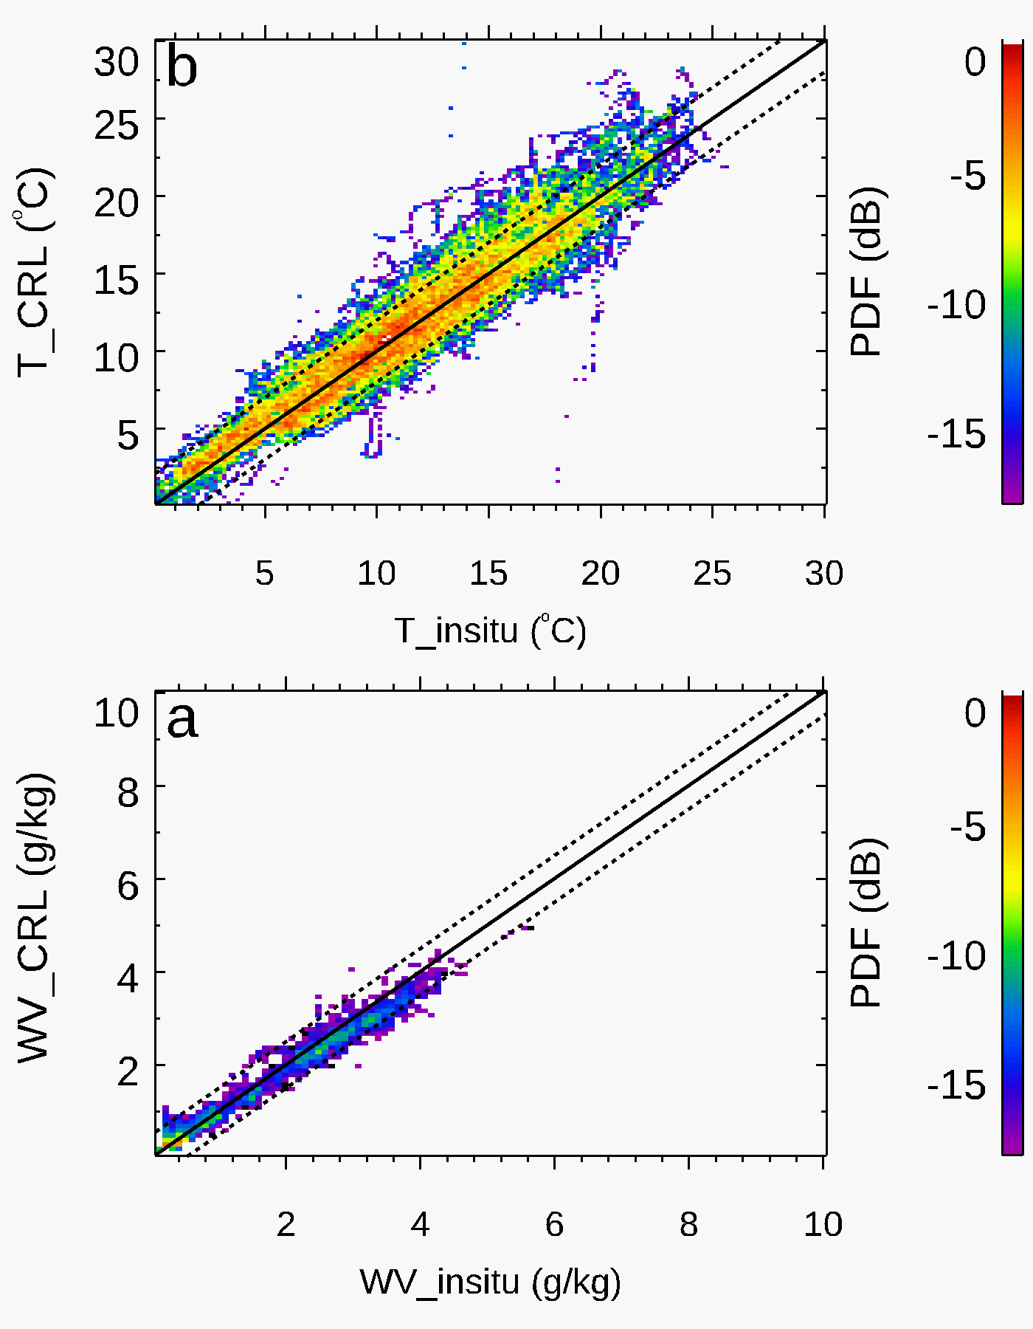
Raman Lidar Measurement Validation
CHEESEHEAD In Situ Measurements
Mean T difference: -0.7 K
Mean WV difference: 0.15 g/kg
SWEX Dropsonde Measurements
1
2
3
4
5
T
CRL
WV
Mean T difference:
-0.34K
Mean WV difference:
0.06 g/kg
Raman lidar can provide reliable water vapor and temperature measurements within PBL!
In Situ

Slide 4
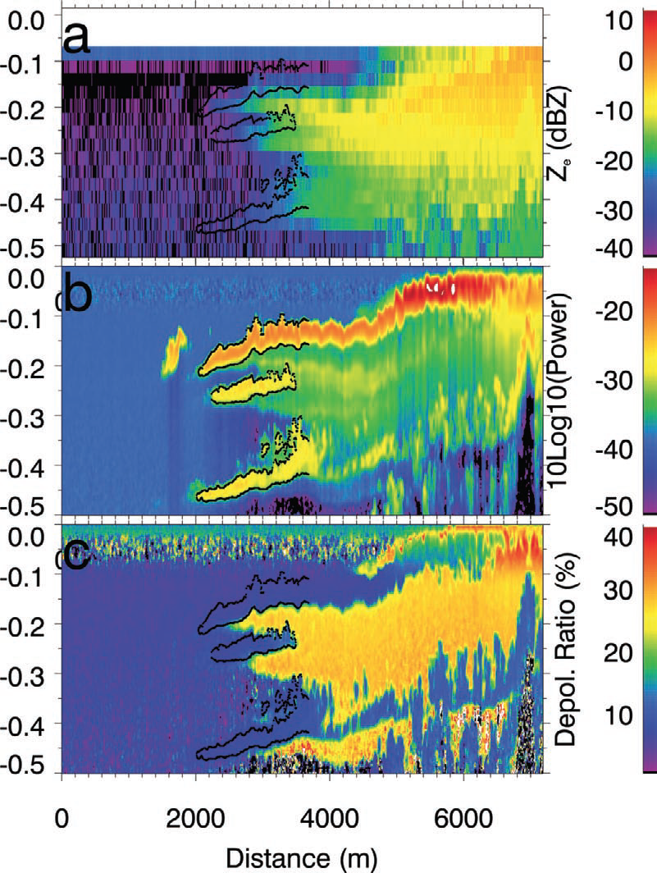
Lidar-radar Synergy for Cloud Structures and Properties
Cloud and Precipitation structures
Cloud phase vertical distributions
Mixed-phase cloud properties

